Slide 1
Pulmonary Transplant
DTSA 5511 Intro to Deep Learning

Slide 2
Background
Organ transplantation is a life-saving procedure for patients with advanced or end-stage diseases
Managed regionally by 56 organ procurement organizations federal contractors which are granted monopoly territories
OPO performance across the country is highly variable, with some OPOs procuring only a fraction of all transplant-viable organs
Task: Develop a deep learning model to identify critical donor characteristics that predict successful pulmonary transplantation, with a focus on maximizing the number of viable lungs transplanted

Slide 3
Dataset
3593
Link to github: Master-of-Data-Science-CU-Boulder-Colorado/Machine Learning/DTSA 5511 Introduction to Deep Learning/Final at main · Vorlon41/Master-of-Data-Science-CU-Boulder-Colorado
Link to the dataset: https://physionet.org/content/orchid/2.0.0/
133,101 deceased donor referrals
8,972 organ donations
13 states covered
Referrals by OPO
OPO 1: 32,148 potential donors
OPO 2: 16,144 potential donors
OPO 3: 12,516 potential donors
OPO 4: 33,641 potential donors
OPO 5: 15,738 potential donors
OPO 6: 22,914 potential donors
There are a total of 3593 potential pulmonary donors, of which 2240 donated the lungs, while 1353 did not.

Slide 4
Data
Parsed time variables and imputed missing with means
Check and confirmed minimal changes to the overall data pre and post
Many labs were missing
Remove > 50% missing
Imputed using KNN
Check and confirmed minimal changes to the overall data pre and post
One hot encoding
Power calculation
80 % powered to detect a difference in lung‐transplant rates of about ±4.8 % or larger between any two equally sized comparison groups.

Slide 5
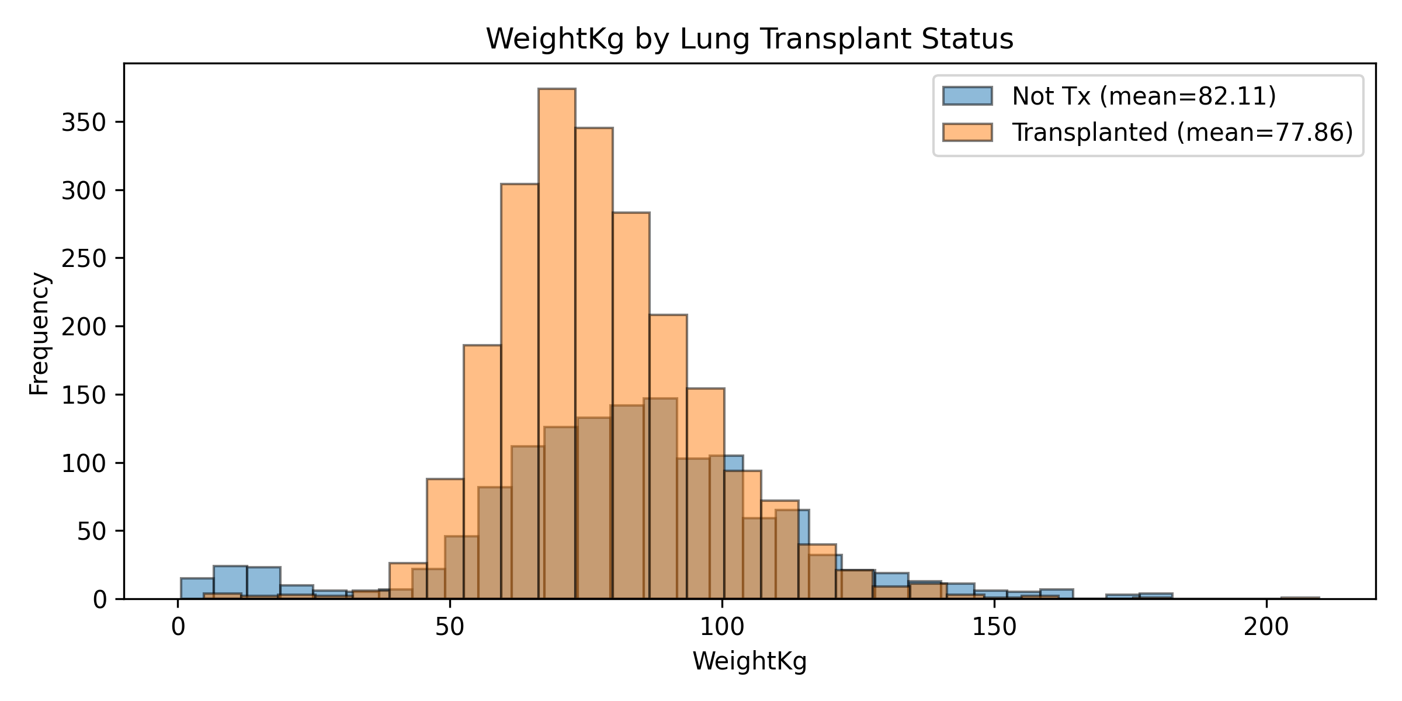
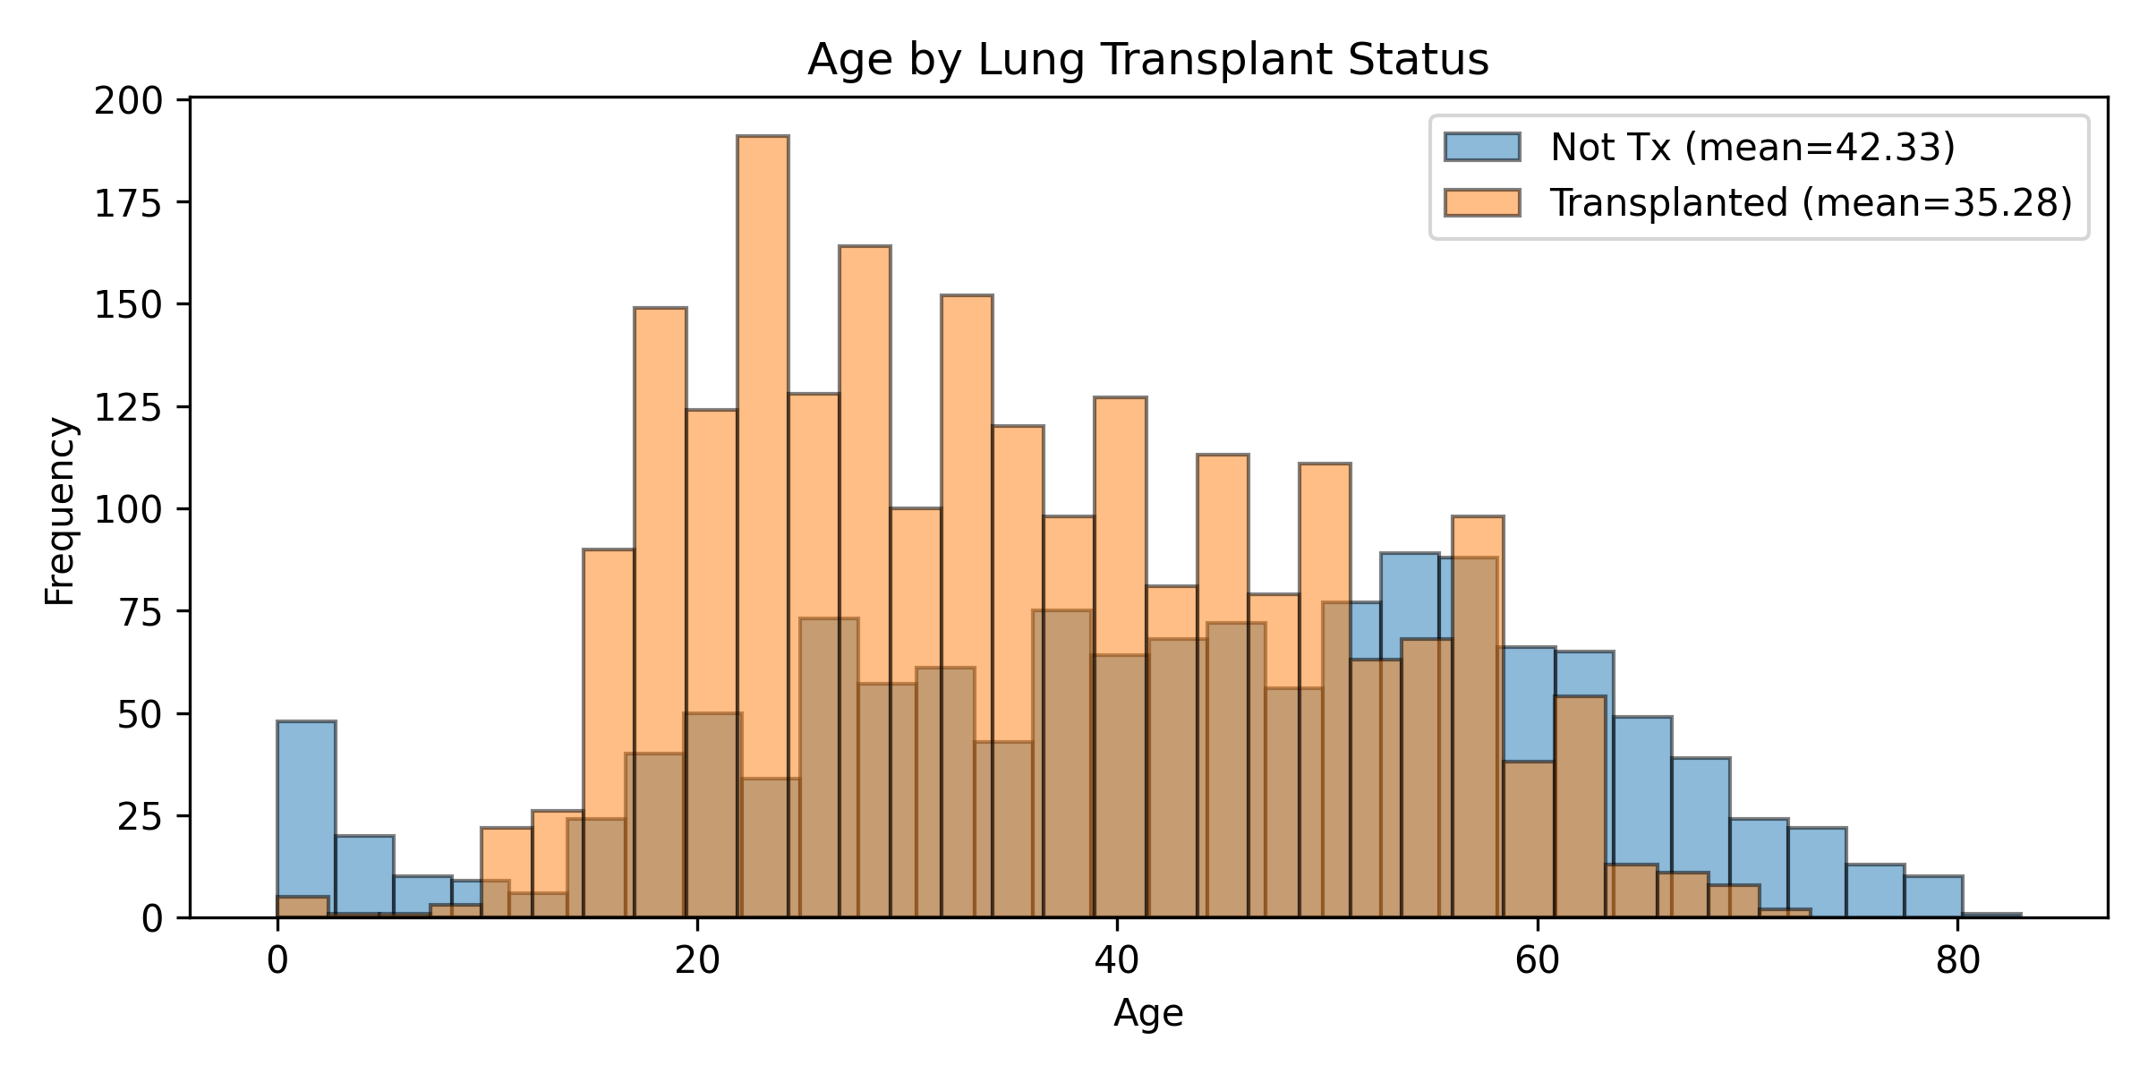
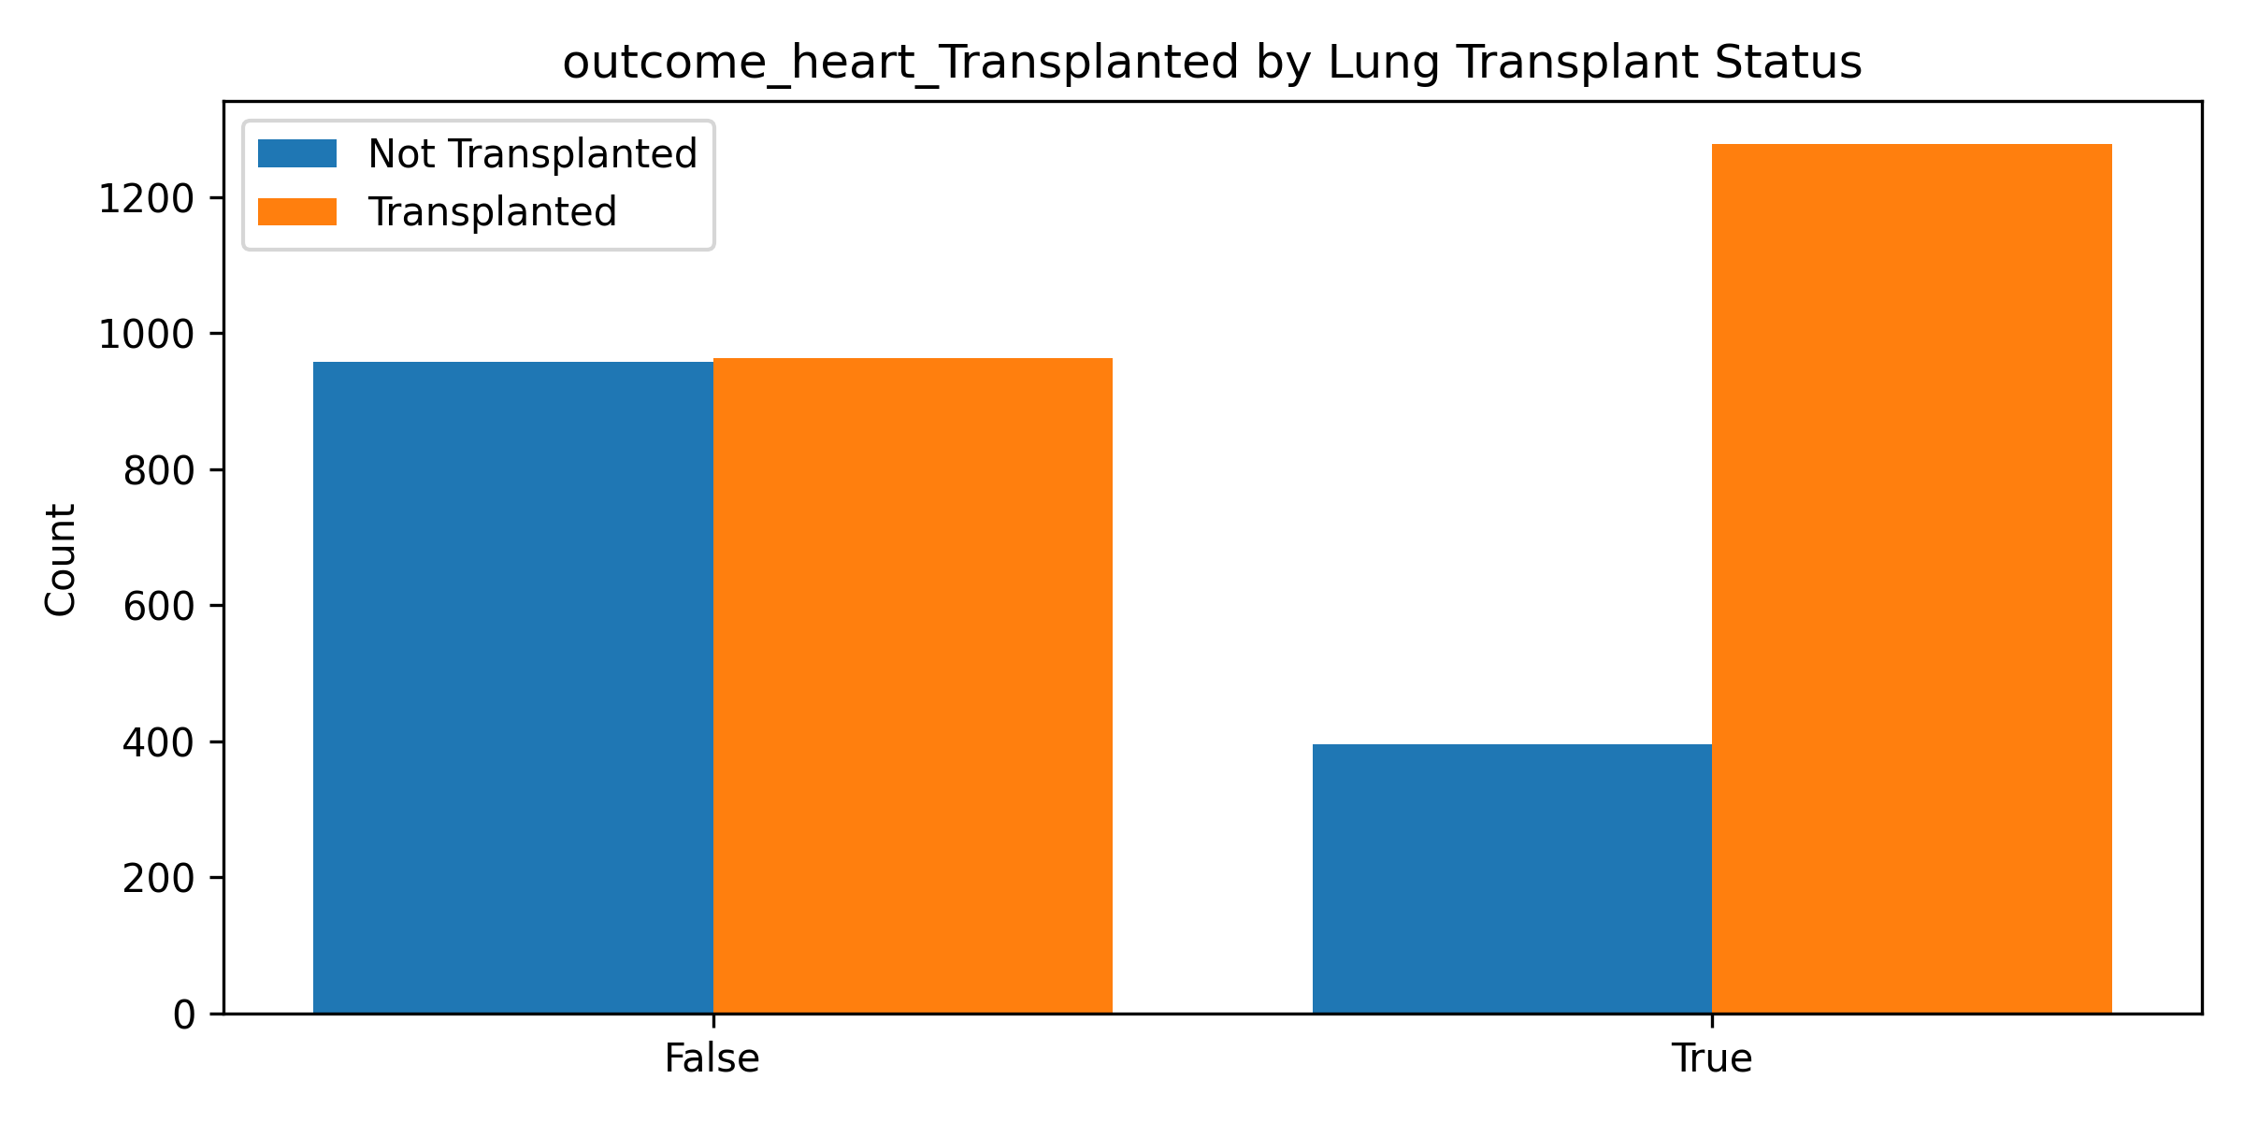
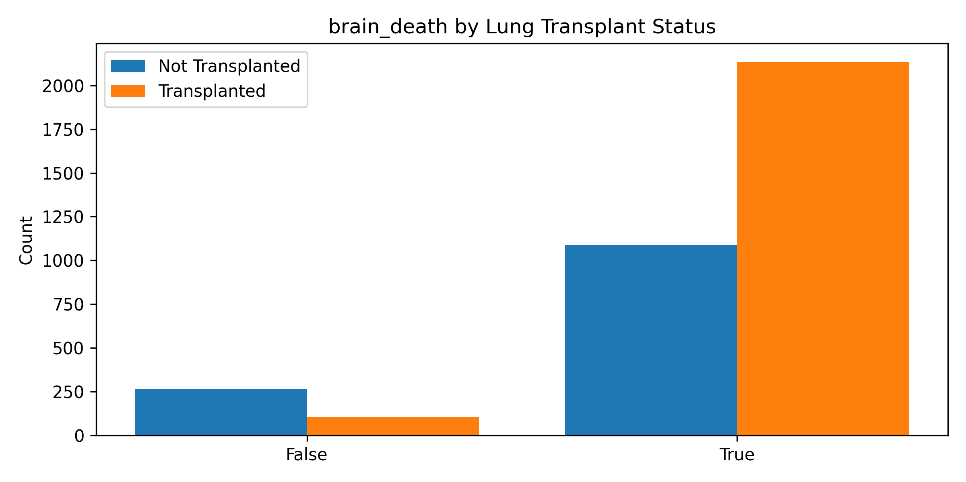
EDA: Histograms

Slide 6
EDA: OPO
feature | level | count_not_transplanted | prop_not_transplanted | CI95_not | count_transplanted | prop_transplanted | CI95_trans | chi2_p | cramers_v
OPO | OPO1 | 232 | 0.171471 | [0.152, 0.192] | 727 | 0.324554 | [0.305, 0.344] | 6E-104 | 0.369787
OPO | OPO2 | 88 | 0.065041 | [0.053, 0.079] | 177 | 0.079018 | [0.069, 0.091] | 6E-104 | 0.369787
OPO | OPO3 | 49 | 0.036216 | [0.028, 0.048] | 116 | 0.051786 | [0.043, 0.062] | 6E-104 | 0.369787
OPO | OPO4 | 789 | 0.583149 | [0.557, 0.609] | 499 | 0.222768 | [0.206, 0.240] | 6E-104 | 0.369787
OPO | OPO5 | 118 | 0.087214 | [0.073, 0.103] | 414 | 0.184821 | [0.169, 0.201] | 6E-104 | 0.369787
OPO | OPO6 | 77 | 0.056911 | [0.046, 0.071] | 307 | 0.137054 | [0.123, 0.152] | 6E-104 | 0.369787

Slide 7
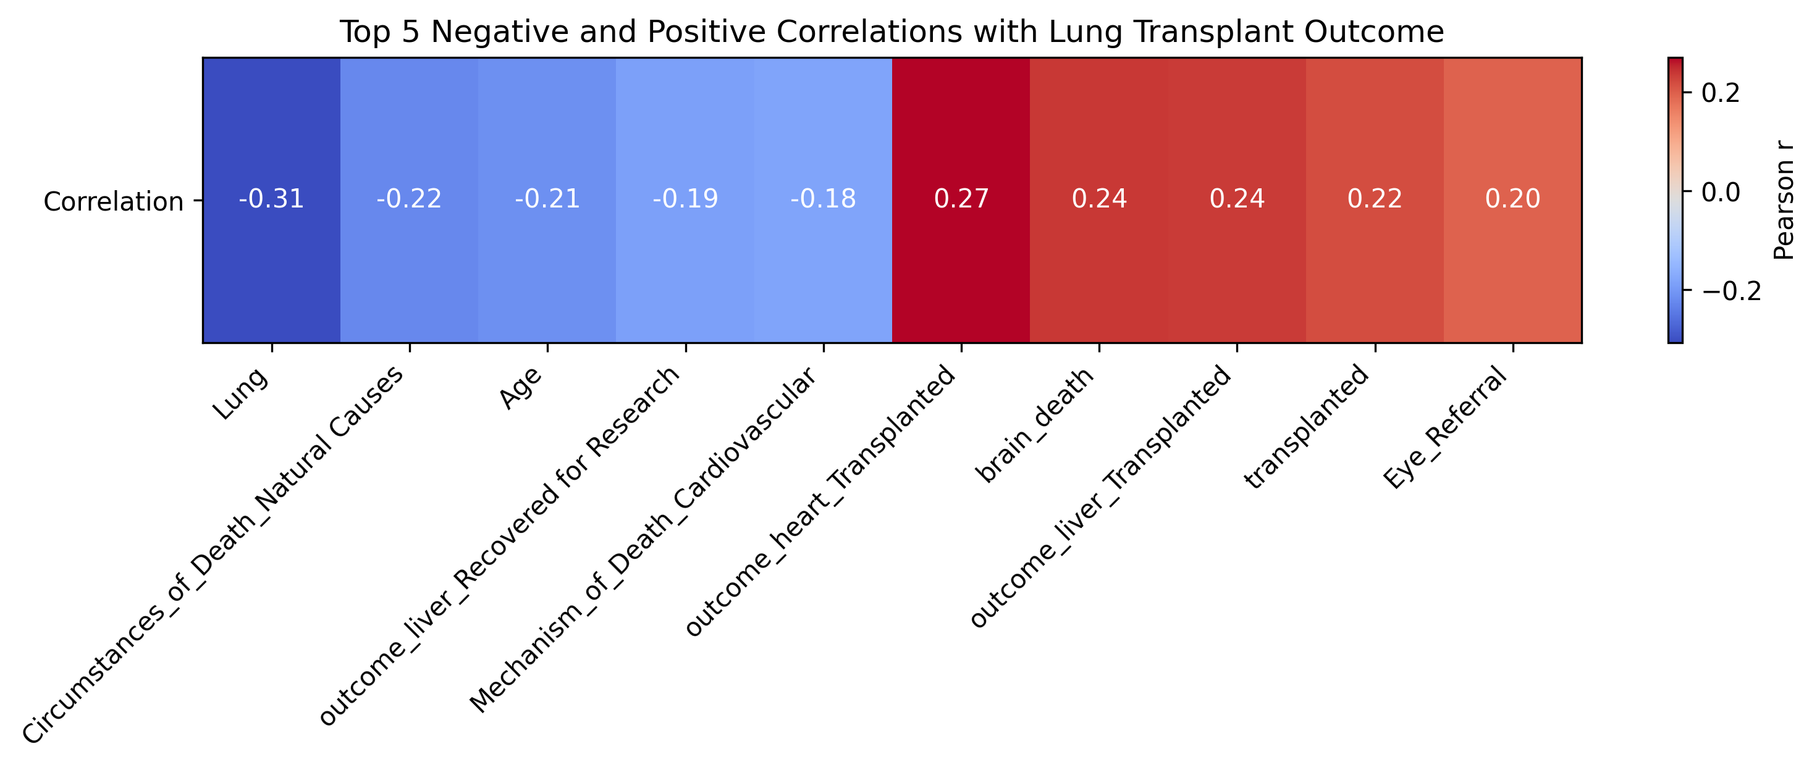
EDA: Correlation

Slide 8
Model: Neural Network
Precision Recall F1-score Support
0 0.000 0.000 0.000 271
1 0.623 1.000 0.768 448
accuracy 0.623 719
macro avg 0.312 0.500 0.384 719
weighted avg 0.388 0.623 0.478 719

Slide 9
Model: NN: Tune:Per‐class weights
Precision Recall F1-score Support
0 0.000 0.000 0.000 271
1 0.623 1.000 0.768 448
accuracy 0.623 719
macro avg 0.312 0.500 0.384 719
weighted avg 0.388 0.623 0.478 719

Slide 10
Model: NN: Tuning: Training on a balanced
Precision Recall F1-score Support
0 0.000 0.000 0.000 271
1 0.623 1.000 0.768 448
accuracy 0.623 719
macro avg 0.312 0.500 0.384 719
weighted avg 0.388 0.623 0.478 719

Slide 11
Model: NN: Hyperparameter Turning
Precision Recall F1-score Support
0 0.000 0.000 0.000 271
1 0.623 1.000 0.768 448
accuracy 0.623 719
macro avg 0.312 0.500 0.384 719
weighted avg 0.388 0.623 0.478 719

Slide 12
Model: NN: Turning: Regularization
Precision Recall F1-score Support
0 0.000 0.000 0.000 271
1 0.623 1.000 0.768 448
accuracy 0.623 719
macro avg 0.312 0.500 0.384 719
weighted avg 0.388 0.623 0.478 719

Slide 13
Model: NN: Tuning: Change the loss fxn
Precision Recall F1-score Support
0 0.000 0.000 0.000 271
1 0.623 1.000 0.768 448
accuracy 0.623 719
macro avg 0.312 0.500 0.384 719
weighted avg 0.388 0.623 0.478 719

Slide 14
Model: Feed Forward NN
Precision Recall F1-score Support
0 0.000 0.000 0.000 271
1 0.623 1.000 0.768 448
accuracy 0.623 719
macro avg 0.312 0.500 0.384 719
weighted avg 0.388 0.623 0.478 719

Slide 15
Model: Random Forrest
Test AUC: 0.849
Precision Recall F1-score Support
0 0.696 0.720 0.708 271
1 0.827 0.810 0.818 448
accuracy 0.776 719
macro avg 0.762 0.765 0.763 719
weighted avg 0.778 0.776 0.777 719

Slide 16
Model: Ensemble
Test AUC: 0.873
Test ACC: 0.816
Precision Recall F1-score Support
0 0.793 0.694 0.740 271
1 0.828 0.891 0.858 448
accuracy 0.816 719
macro avg 0.811 0.792 0.799 719
weighted avg 0.815 0.816 0.814 719

Slide 17
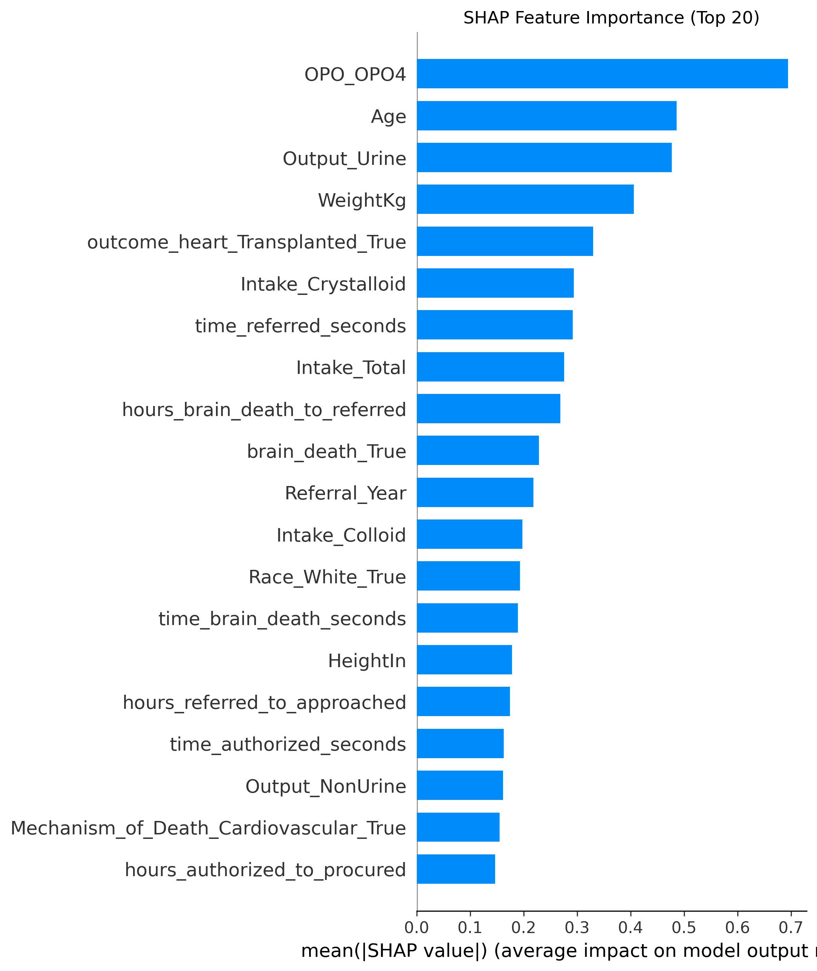
Model: Ensemble
Younger donors carry a higher predicted probability of lung donation
Larger body‐size (Weight, Height) plays a modest positive role
High urine output during donor management (and low non‐urine output) strongly favors
Whether the heart was also transplanted has a noticeable positive effect
A cardiovascular mechanism of death likewise nudges the model toward a successful donation
Shorter intervals from brain death to referral and from referral through authorization

Slide 18
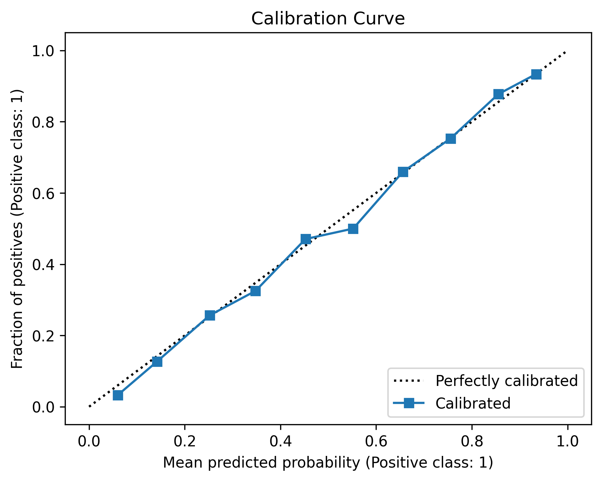
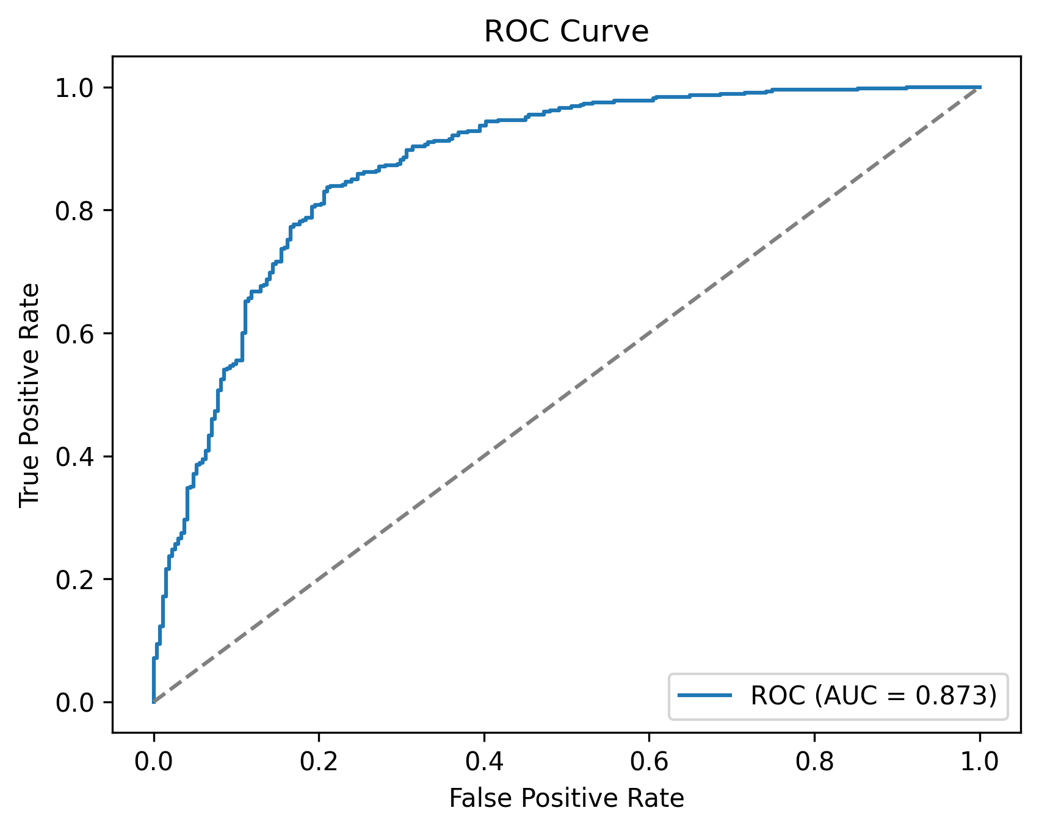
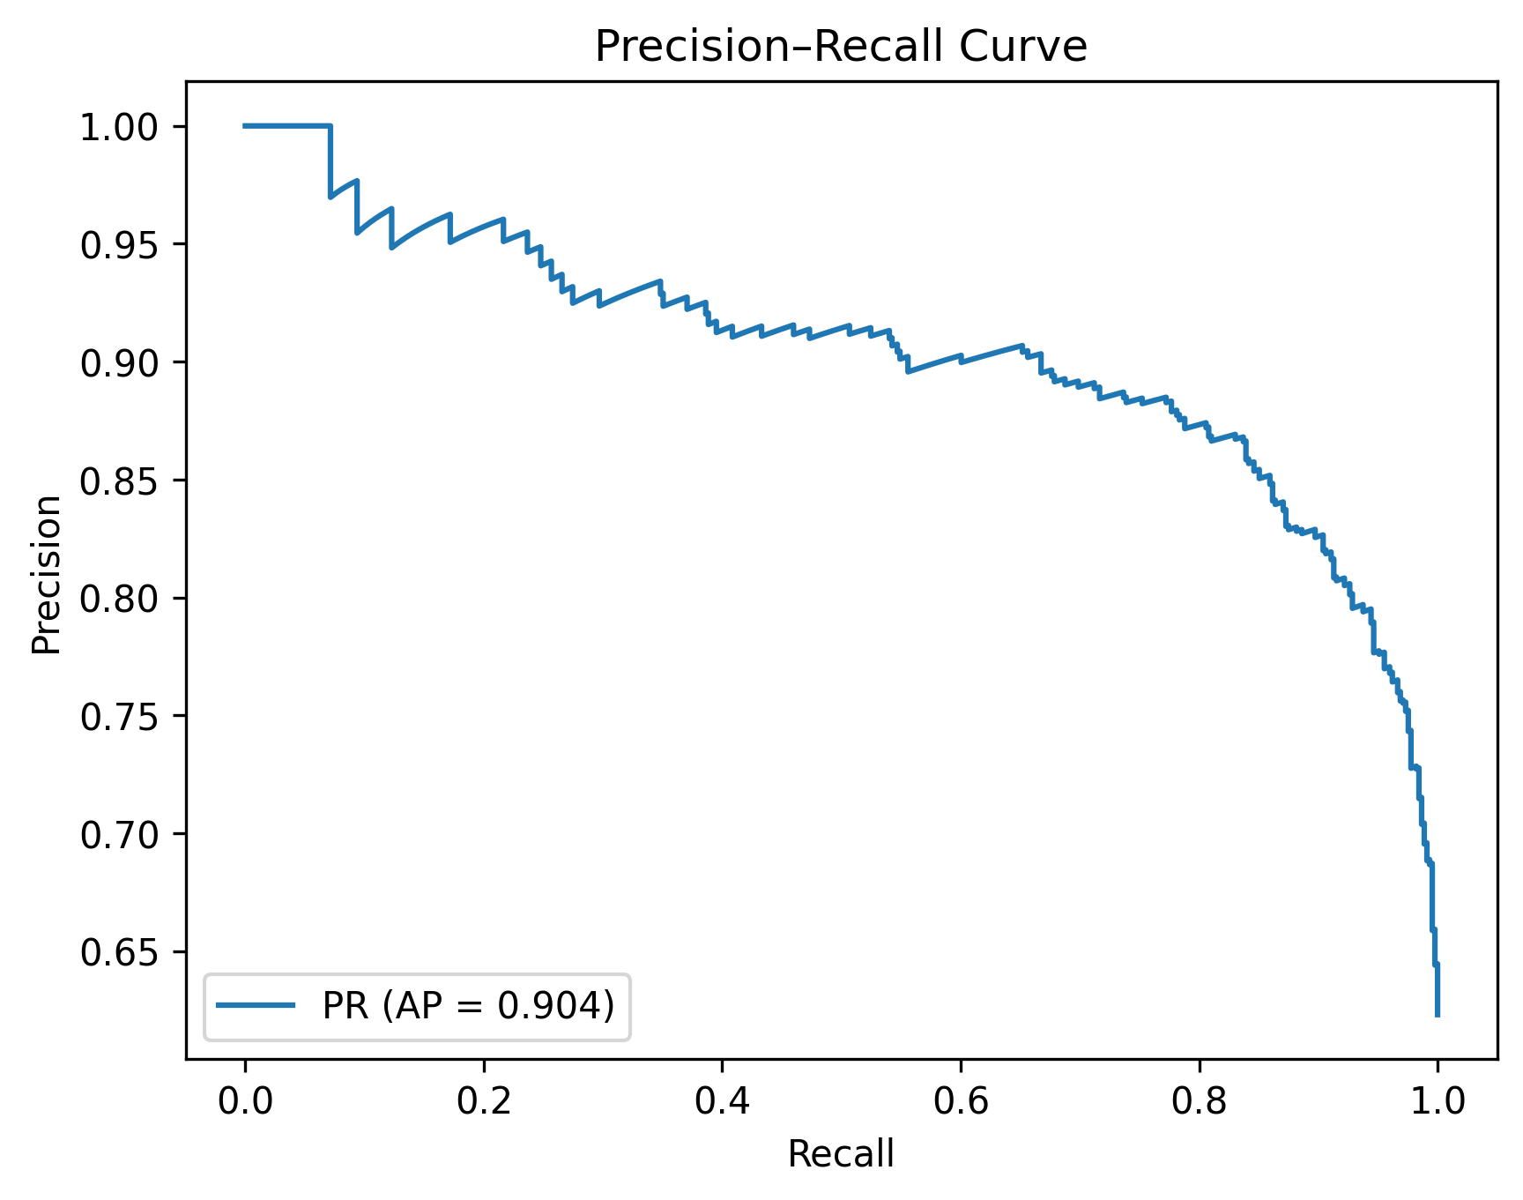
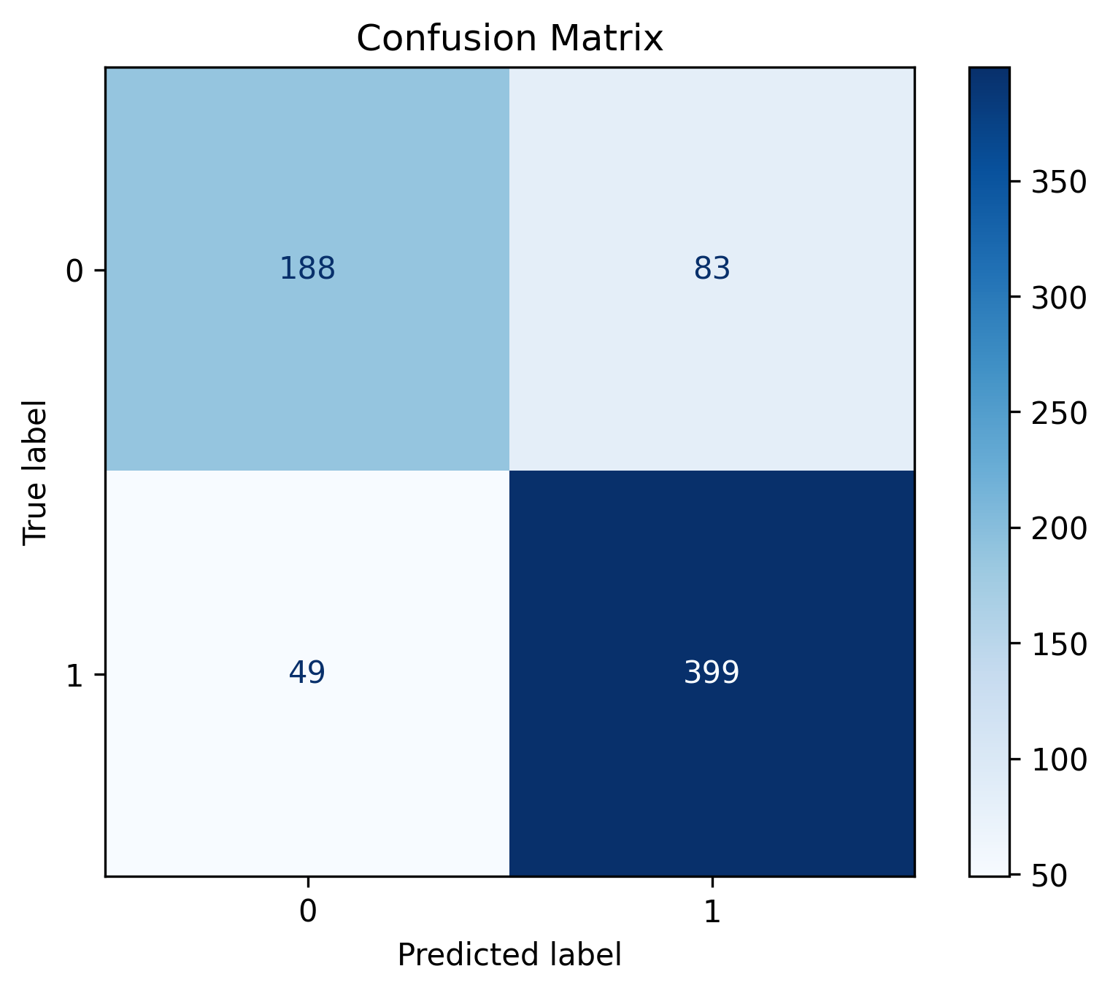
Ensemble

Slide 19
Gradient boosting, eXtreme gradient boosting, and a calibrated SVM (SVC)
Fold Precision Recall F1 Accuracy
1 0.824 0.866 0.844 0.801
2 0.817 0.897 0.855 0.811
3 0.819 0.906 0.860 0.816
4 0.813 0.884 0.847 0.801
5 0.818 0.893 0.854 0.809
Metric Mean Std
Precision 0.818108 0.003811
Recall 0.889286 0.015270
F1 0.852146 0.006385
Accuracy 0.807680 0.006681

Slide 20
Conclusion
Task: Develop a deep learning model to predict pulmonary transplant donation
Developed multiple deep learning model with multiple tuning parameters -> failed to obtain good results due to memorization
Developed supervised learning models
Best was ensemble: Gradient boosting, eXtreme gradient boosting, and a calibrated SVM (SVC)
Good generalization
Logistical factors (e.g. OPO) and core clinical metrics (e.g. age, fluid outputs, inf) jointly drive the model’s transplant‐suitability predictions.

